Slide 1




SeniorCareux
RRUPESH NIKHIL ABHAY NIRBHAY GILL
Under supervision of Internal-Dr Anshu K.R ftangalam
University
School of Engineering and
Technology
Information available in audio.

Slide 2

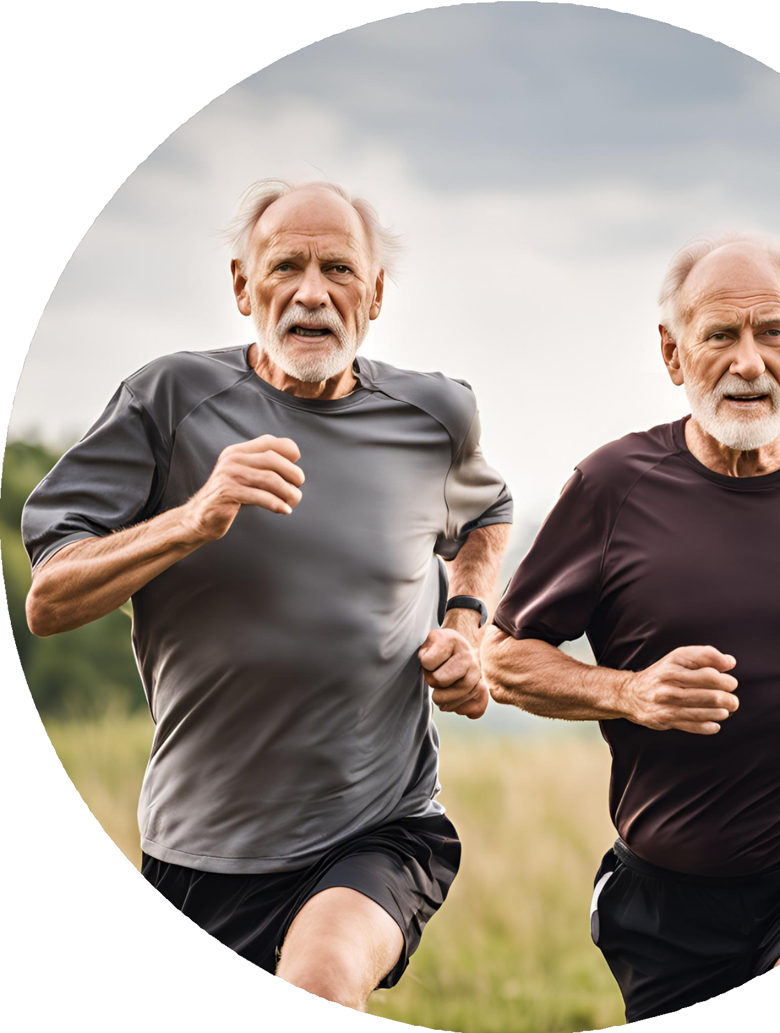
Introduction
A app for our senior citizen to provide them health tracking,exercise and health tips and medicine reminders.Provide them simple navigation and large fonts to clear visiblity.Give them real world senior on screen like: never forgot your medicines and other friendly reminders to track them.

Slide 3

PROBLEM STATEMENT
In modern time there are many apps related for fitness , but these apps are only for youngster’s .Our senior citizens are completly trapped by diseases like high blood pressure, anxiety ,depression and many other types diseases. they also wants a app related to their fitness and health

Slide 4


Data related senior citizens
SECONDARY
RESEARCH
Physical Activity Levels:
28% of adults aged 60+ are not sufficiently active (WHO).
In the U.S., only 16.2% of seniors meet exercise guidelines; 12% in the U.K.
Health Impact:
Regular exercise can lower chronic disease risks by 30-50% and reduce mortality by 28%.
20% lower risk of falls with regular activity (WHO).
Sedentary Behavior:
60-70% of seniors spend over 8 hours per day sitting, increasing health risks.
Cognitive Health:
Exercise reduces the risk of Alzheimer’s by 40% (Neurology).
Economic Impact:
Physical inactivity in seniors results in $54 billion in healthcare costs (WHO).

Slide 5



Primary research
1).What kinds of physical activities do you currently enjoy or find easy to do?
2).Are there any physical limitations or health concerns that make it challenging for you to stay active?
3).What goals do you have for your physical health or fitness?
4).Do you feel comfortable and confident exercising on your own, or do you prefer group activities?
5).How important is staying physically active to you, and why?
6).Have you noticed any specific benefits from the exercises you do, like improved energy or mobility?
7).What are some obstacles that make it difficult for you to exercise regularly?
8).Do you have access to resources like fitness classes, walking trails, or gym facilities?
9).Are you interested in learning more about exercises that are specifically designed for older adults?
10).How has your approach to exercise changed over the years?

Slide 6
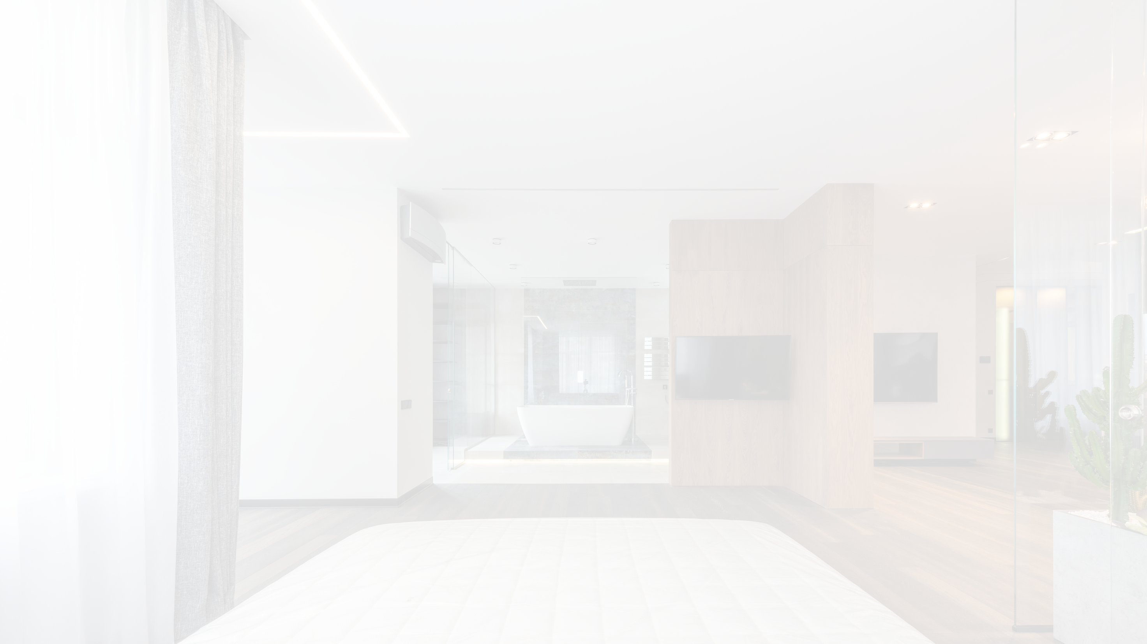
user-10
mode- telling communication
"I enjoy walking in my neighborhood, doing light stretching, and sometimes joining a water aerobics class at the community center."
"Yes, I have some arthritis in my knees, and certain exercises can make it worse. I also sometimes feel unsteady, so I avoid activities where I might lose my balance."
"I’d like to stay independent as long as possible, so my main goals are to improve my balance and keep my strength up to make everyday tasks easier."
"I feel more comfortable in a group setting where there’s an instructor, especially since I’m worried about injuring myself if I do something wrong."
"It’s very important to me. I want to be able to enjoy life, keep up with my grandchildren, and avoid being a burden on my family."
"Definitely! I feel more energetic, and my joint pain seems more manageable when I keep up with my exercises. I also find it easier to get up from chairs and walk up stairs."
"Sometimes, I feel too tired or have flare-ups with my arthritis. Also, I don’t always have someone to join me, and it can feel a bit lonely exercising on my own."
"Yes, but only limited options. There’s a local gym, but it’s not very senior-friendly. I have access to some online classes, though, which helps when I can’t go out."
"Yes, I’d love that. I feel safer knowing the exercises are geared towards seniors, so I don’t push myself too hard and risk injury."
"When I was younger, I didn’t worry as much about exercise because I stayed active with work and family. Now, I’m more focused on low-impact exercises and movements that help me with my balance and strength."

Slide 7

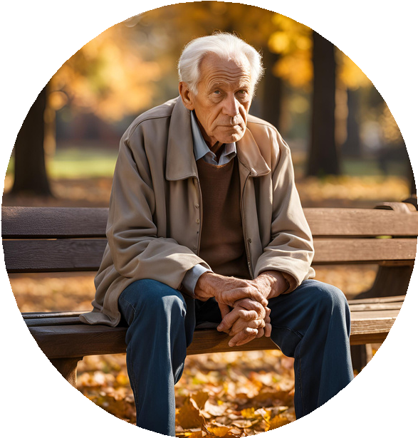




Retired Policeman:
Goals
Wants to get easy to use app or platform for better workout or exercise plans according to levels.
Pain Points
Feel frustration during using other fitness app and they have
complex interface ,which is not easy to use and these apps provide exercise which are related to young people.
Nakul Das
Age
68
Status
Location
married
Delhi
Needs
wants a app which is easy to use has not complex interface easy to use and provide exercise for him.
Personality
Extrovert busy in life
About
Nakul Das, is a retired policeman in delhi. After retirement he is facing related to heart, depression ,anxiety and he wants a app related to fitness.
Interest
Nakul Das usually interested in cycling and reading books and also interested in travelling .

Slide 8
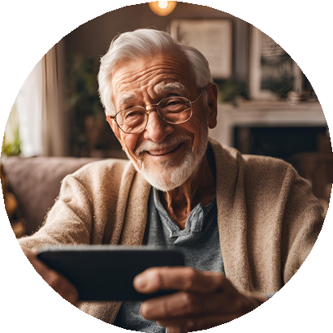
Retired engineer:
TIP: Duplicate these pages to repeat the exercise for another persona.
Name. Rob Age. 65
Bio
Rob is a retired engineer who lives in rural area of australia near some natural resources . His family leaves out of that areas .He is living with his wife and his elder son working at sydney and younger son is reading in US.
Location.
Technology.
Perth,Australia low proficiency
Needs
Goals
wanted a reliable app with a good response and support team from app (customer care) not wanted any issue related to payment method and need a better diet plan from app
want that doing execise in a way that it;s benefical for its body and in a good price not costly (wanted a budget friendly and wanted to achieve a good result from it )
Pain point
Rob was a person who lives in a village he have a issue related to its fitness and there is no senior citzen gym in their area and he couldn’t find any app which provide him a good deal according to their price

Slide 9
In a research is seen that seniors citizens usually face problem related to operate complex interface and these apps mainly give exercise for younger people.These apps have small fonts and not suitable according to there age and they have lack of experience of these apps and not provide proper exercise chart for seniors.
Pain point analysis

Slide 10
UNDERSTAND SENIOR FITNESS NEEDS
Give them low impact exercises to maintain there strength,balance and flexibility. also give them health tracking feature for monitring their health.
ACCESSIBILITY FEATURES
Give them large fonts and buttons with simple design,with dark background. some special features like voice command and text with speech also given for better experience.
Possible solution
SIMPLE UX AND CUSTOMIZABLE WORKOUT
Simple process of sign up with sign up video with clear nevigation for frequent action.
Pre set fitness levels like beginner , intermediate , advance also with exercise modification with rest break and goal based programme.

Slide 11


Ideation
Fitness programme
Easy interface with big icons
Medication suggestion
Give weekly or monthly fitness programme after Finshing them give some discount on Permium plans
Easy to login and understand interface not complex to understand give big buttons and Icons to better user experience
Give suggestion weekly related to your heart related checkup and blood pressure and diabetes (sugar level) related checkup
Special exercise for physically disturbed people
Also give emergency calling option to family in any emergency
online classes related to medical

Slide 12
Brainstorming
HOME
DISCOVER
PROFILE
Activity
SEARCH BAR
cycling
GOALS
PERSONAL DETAIL
HEART RATE
VOICE COMMAND
ACHIVEMENTS
TRENDING WORKOUT
WALKING COUNT
CATEGORIES WORKOUT
RECENT WORKOUT
AEROBIC CAPACITY

Slide 13
Wireframing:

